Slide 1

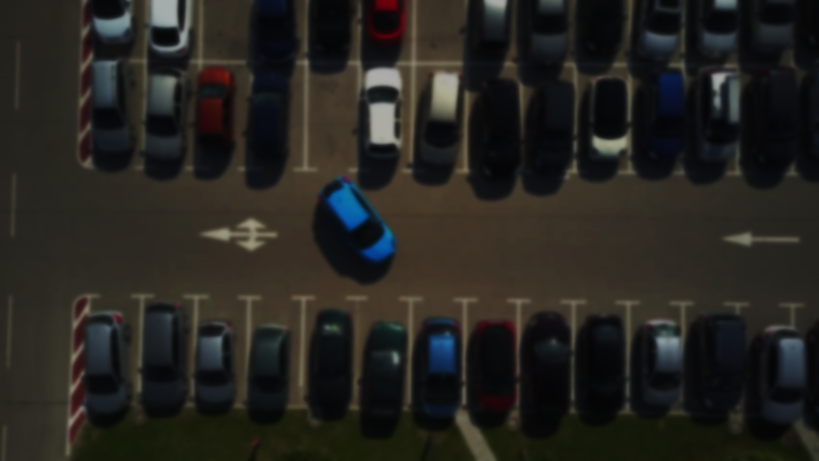
Vehicle Movement Analysis and Insight Generation Project
Team Members:
1.Santhoshini.S -2106212430036
2.Deepika.M -210621243008

Slide 2
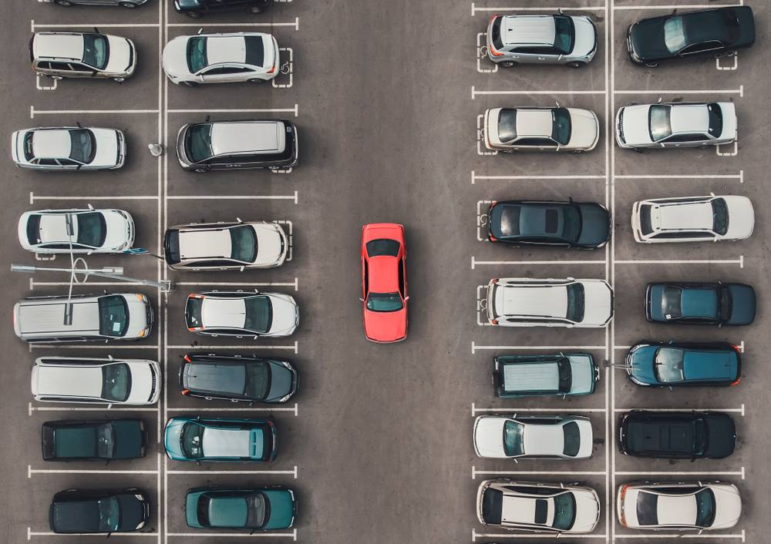
Introduction
Problem Statement:
Managing vehicle movement and parking in a college campus can be a challenging task. An intelligent system that can analyze vehicle movement, monitor parking occupancy, and match vehicles to an approved database can significantly improve campus security and management.

Slide 3

Objective: Develop an Edge AI-based solution that analyzes vehicle movement using data from cameras capturing vehicle photos and license plates . Provide insights on vehicle movement patterns, parking occupancy, and match vehicles to an approved vehicle database.

Slide 4
Dataset Description
Source:
Image data collected from cameras installed at campus entrances, exits, and parking lots.
Key Features:
Vehicle images
01
License plate images
02
CORRESPONDING TIMESTAMPS
03

Slide 5
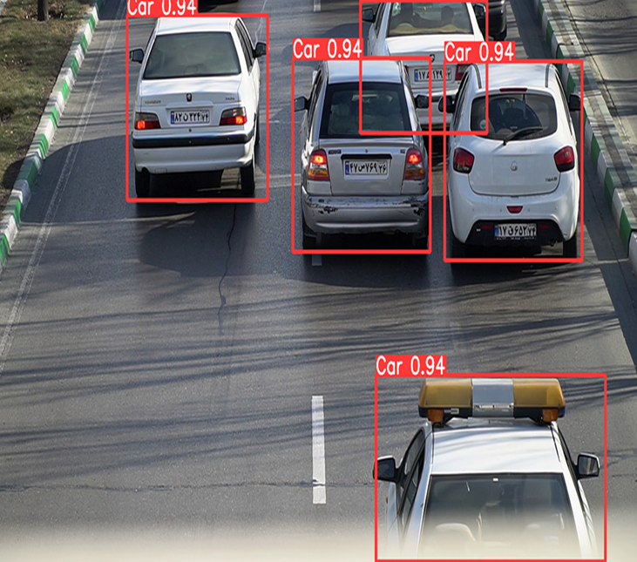
Methodology
Step 1: Load the Dataset
Tools: Python, OpenCV
Techniques: Load images and timestamps, display sample images
Step 2: Data Preprocessing
Tools: OpenCV, Pandas, NumPy
Techniques: Image resizing, grayscale conversion, handling missing values

Slide 6
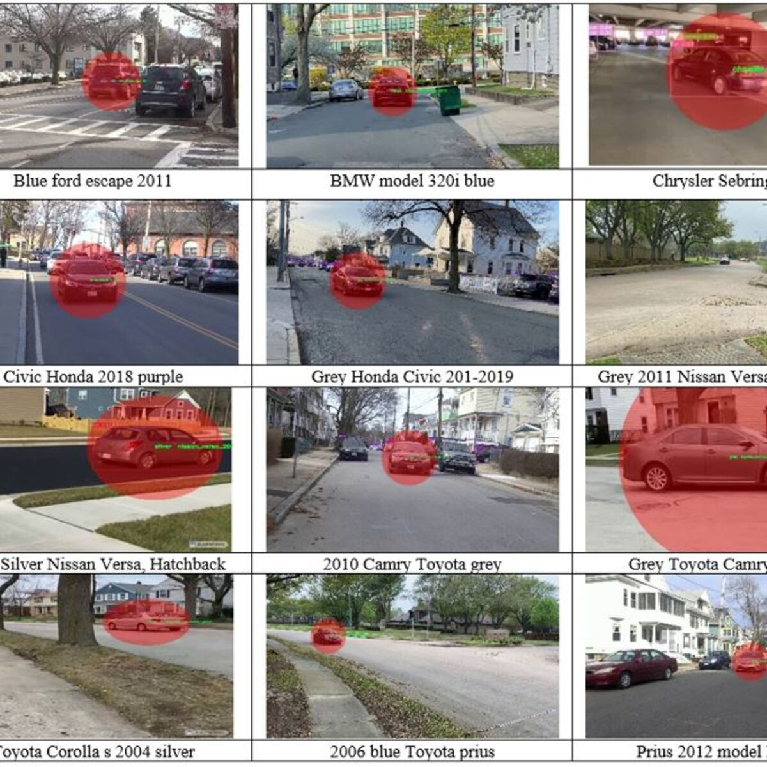
Methodology
Step 3: Exploratory Data Analysis (EDA)
Tools: Matplotlib, Seaborn
Techniques: Plotting vehicle entry/exit times, occupancy trends
Step 4: Vehicle Matching
Tools: OpenCV, Tesseract OCR
Techniques: License plate recognition, database matching

Slide 7

Methodology
Step 5: Insight Generation
Tools: Pandas, Matplotlib
Techniques: Generating insights from movement patterns, parking data
Step 6: Implementing the Solution in a Scalable Manner
Tools: TensorFlow Lite, OpenVINO
Techniques: Deploying AI models on Edge devices
Step 7: Creating a User-friendly Interface
Tools: Flask, HTML, CSS
Techniques: Developing a web interface to display insights

Slide 8
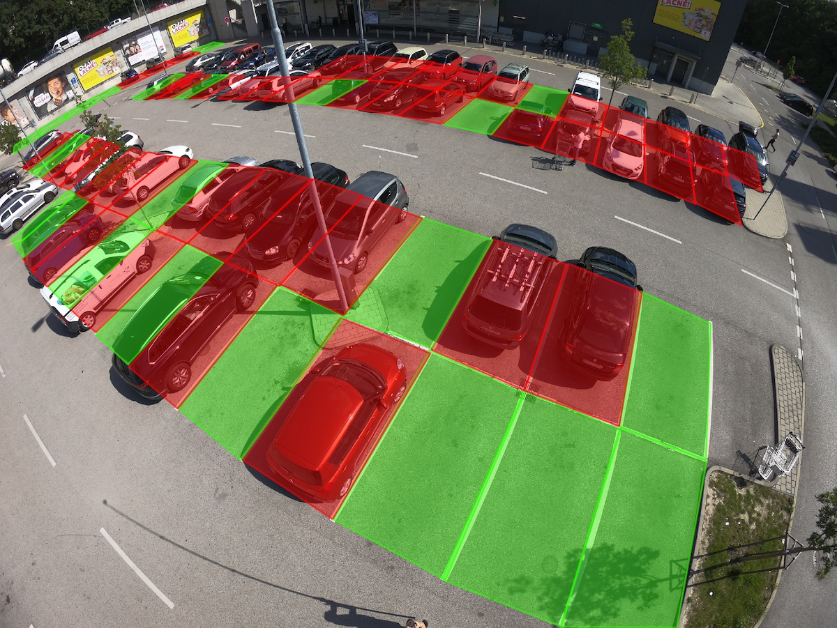
Results and Discussion
Vehicle Movement Patterns
Parking Occupancy
Vehicle Matching

Slide 9

Conclusion
Summarizing Findings and Future Work
The Edge AI-based solution significantly improves campus security and management by accurately analyzing vehicle movement and parking occupancy, and effectively matching vehicles to the approved database.
Future work includes refining AI models for better accuracy and integrating with additional campus security systems for enhanced monitoring.

Slide 10
References
https://www.kaggle.com/datasets/mrdheer/cars-dataset
https://gretel.ai/?kw=gretel%20ai&cpn=19789525426&gad_source=1&gclid=Cj0KCQjwkdO0BhDxARIsANkNcrfbMAxOv44CyyyqKlotKkWANRzBiQ5jZRa30c4so2mPg4Nq7zGPmO0aAkv6EALw_wcB
https://viso.ai/application/parking-lot-occupancy-detection/

Slide 11
THANK YOU

